Slide 1
Chapter 4
Functions
Objectives
❏ To design and implement programs with more than one function
❏ To be able to design multi-function programs
❏ To understand the purpose of the function declaration, call, and definition
❏ To understand the four basic function designs
❏ To understand how two functions communicate through parameters
❏ To understand the differences between global and local scope

Slide 2
FIGURE 4-1 Derived Types

Slide 3
4-1 Designing Structured
Programs
The programs we have presented so far have been very simple. They solved problems that could be understood without too much effort.
The principles of top–down design and structured programming dictate that a program should be divided into a main module and its related modules. Each module should also be divided into submodules according to software engineering principles that we discuss in Section 4.8, “Software Engineering.”

Slide 4
Note
In top–down design, a program is divided into a main module and its related modules.
Each module is in turn divided into submodules until the resulting modules are intrinsic; that is, until they are implicitly understood without further division.

Slide 5
FIGURE 4-2 Structure Chart

Slide 6
4-2 Functions in C
In C, the idea of top–down design is done using functions. A C program is made of one or more functions, one and only one of which must be named
main.
In general, the purpose of a function is to receive zero or more pieces of data, operate on them, and return at most one piece of data. At the same time, a function can have a side effect. A function side effect is an action that results in a change in the state of the program.

Slide 7
Note
In C, a program is made of one or more functions, one and only one of which must be called main.
The execution of the program always starts
with main, but it can call other functions
to do some part of the job.

Slide 8
FIGURE 4-3 Structure Chart for a C Program

Slide 9
FIGURE 4-4 Function Concept

Slide 10
Note
A function in C can have a return value,
a side effect, or both.
The side effect occurs before the value is returned. The function’s value is the value in the expression of
the return statement. A function can be called
for its value, its side effect, or both.

Slide 11
PROGRAM 4-1
Sample Program with Subfunction

Slide 12
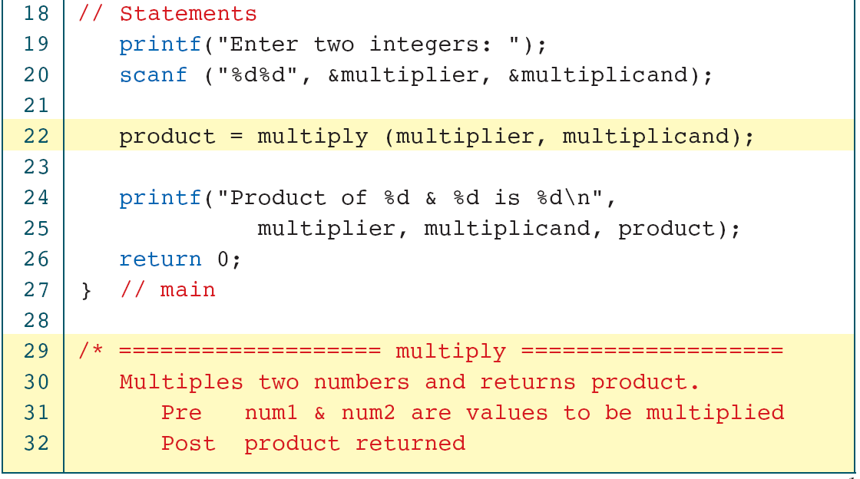

Slide 13
4-3 User-Defined Functions
Like every other object in C, functions must be both declared and defined. The function declaration gives the whole picture of the function that needs to be defined later. The function definition contains the code for a function.
Topics discussed in this section:
Basic Function Designs
Function Definition
Function Declaration
The Function Call

Slide 14
Note
A function name is used three times: for declaration, in a call, and for definition.

Slide 15
Defining Function
FIGURE 4-5 Declaring, Calling, and Defining Functions

Slide 16
FIGURE 4-6 void Function with Parameters

Slide 17
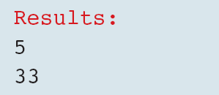
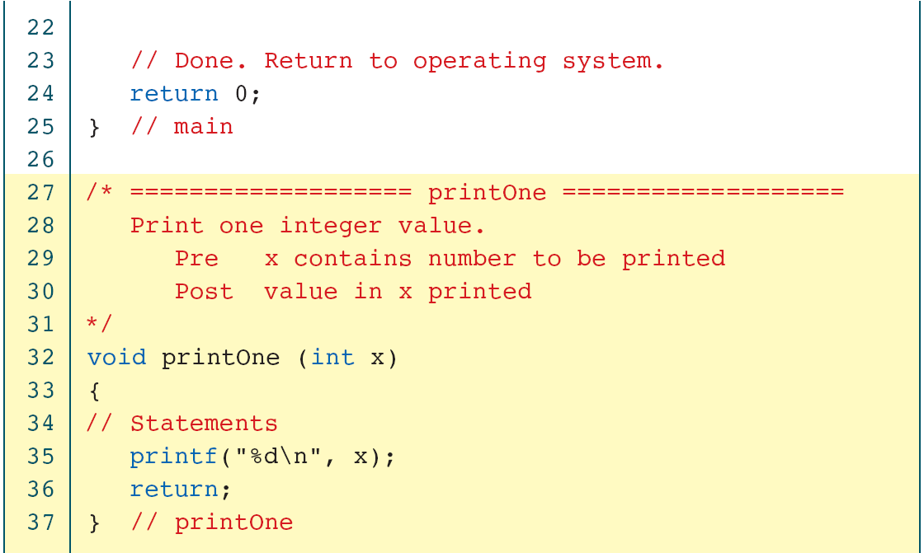
PROGRAM 4-2
void Function with a Parameter

Slide 18
FIGURE 4-7 Non-void Function without Parameters

Slide 19
FIGURE 4-8 Calling a Function That Returns a Value

Slide 20
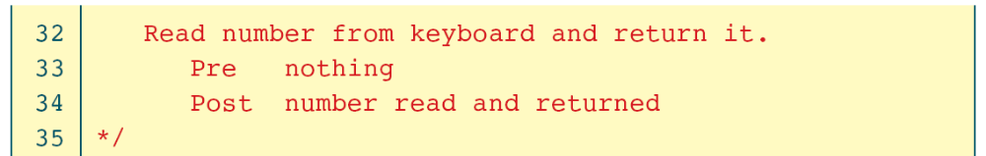
PROGRAM 4-3
Read a Number and Square It

Slide 22
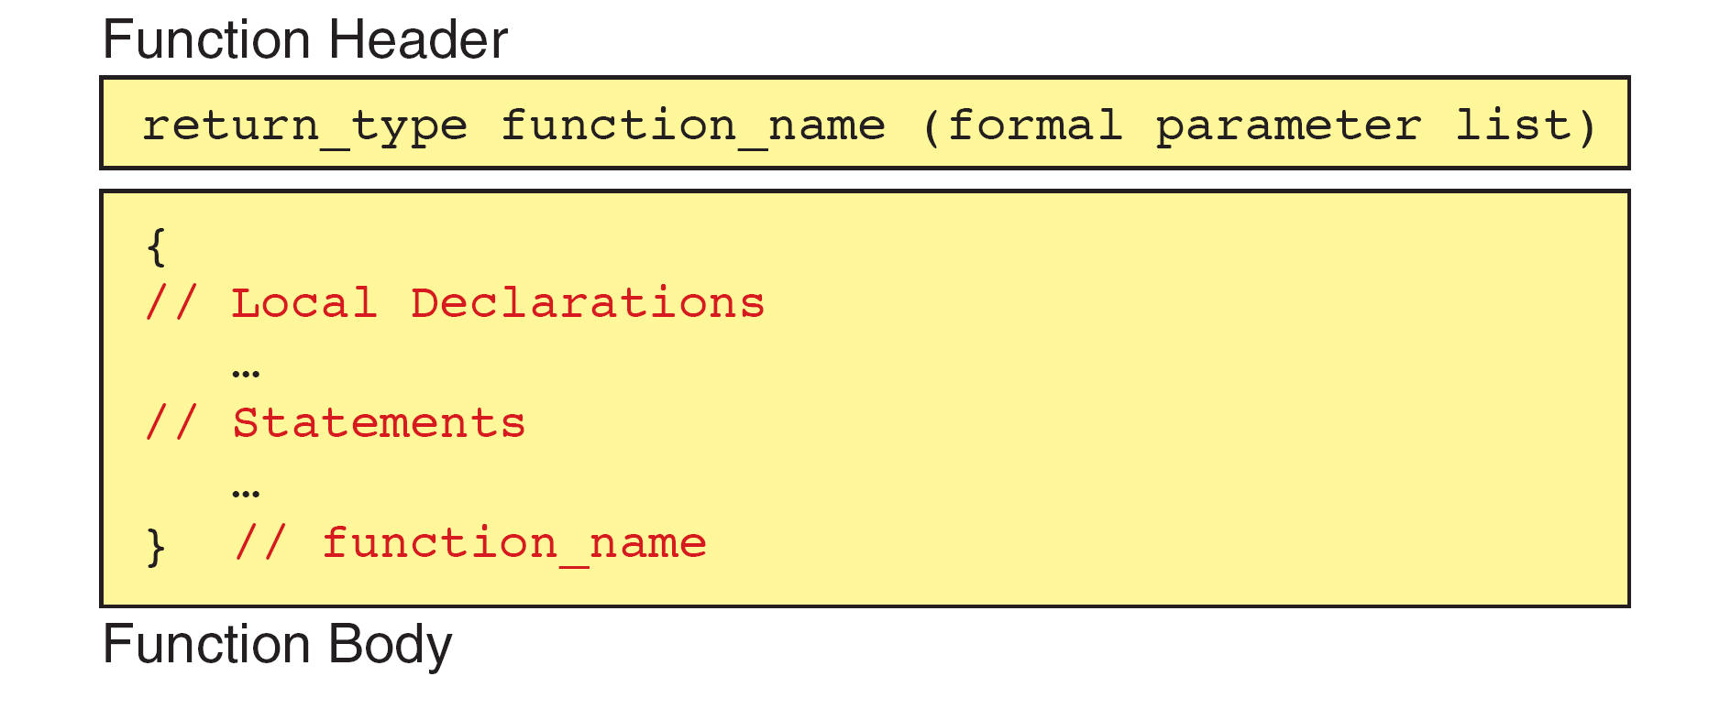
FIGURE 4-9 Function Definition

Slide 23
FIGURE 4-10 Function Return Statements

Slide 24
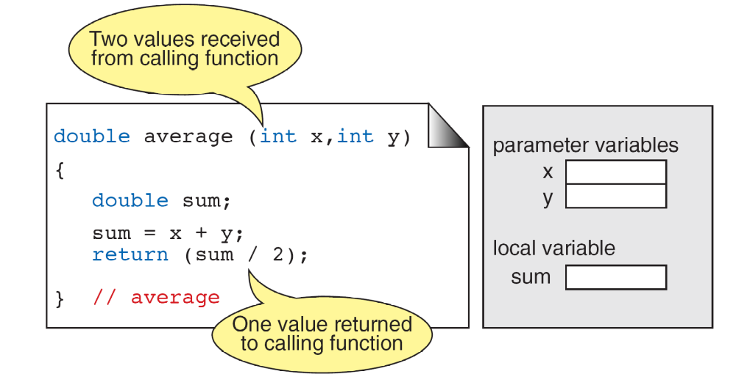
FIGURE 4-11 Function Local Variables

Slide 25
Note
Formal and Actual Parameters
Formal parameters are variables that are declared in the header of the function definition.
Actual parameters are the expressions in the calling statement.
Formal and actual parameters must match exactly in type, order, and number.
Their names, however, do not need to match.

Slide 26
FIGURE 4-12 Parts of a Function Call

Slide 27
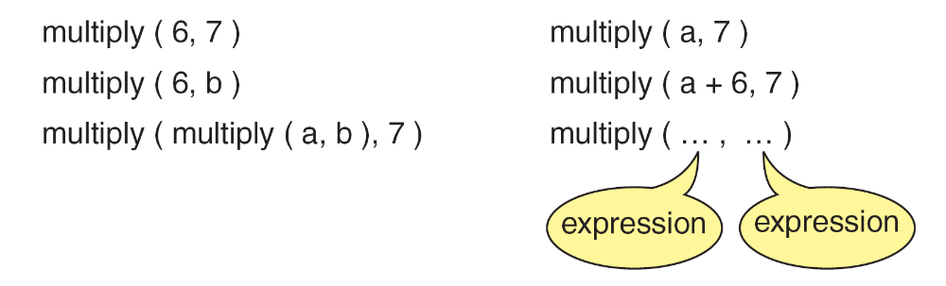
FIGURE 4-13 Examples of Function Calls

Slide 28
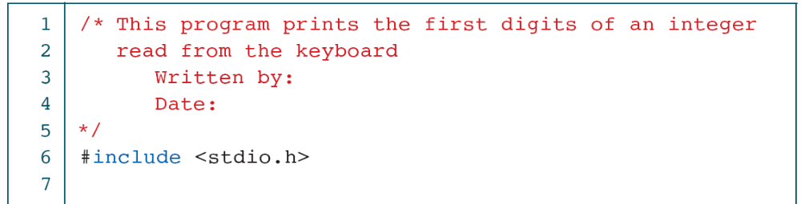
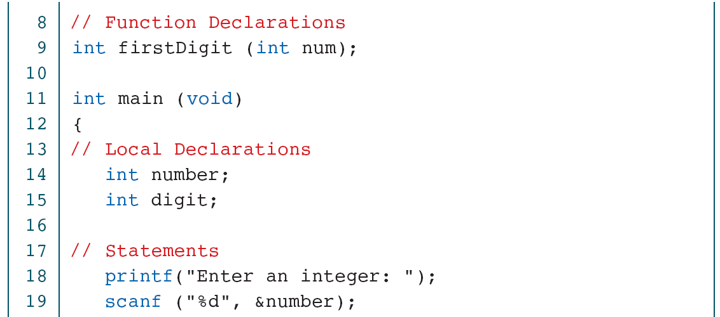
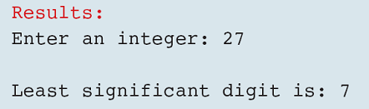
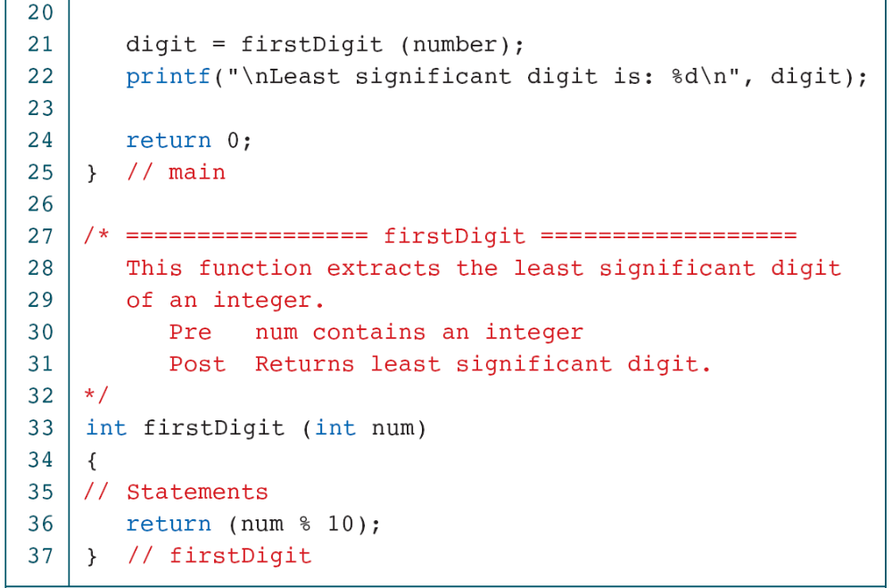
PROGRAM 4-4
Print Least Significant Digit

Slide 29
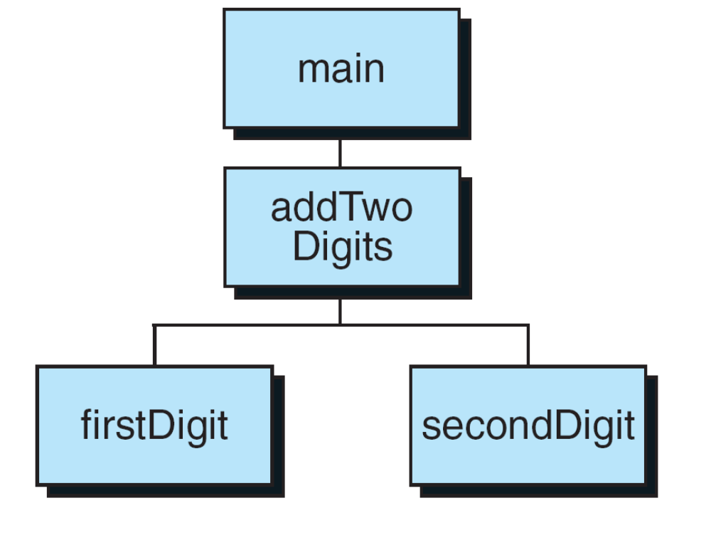
FIGURE 4-14 Design for Add Two Digits

Slide 30
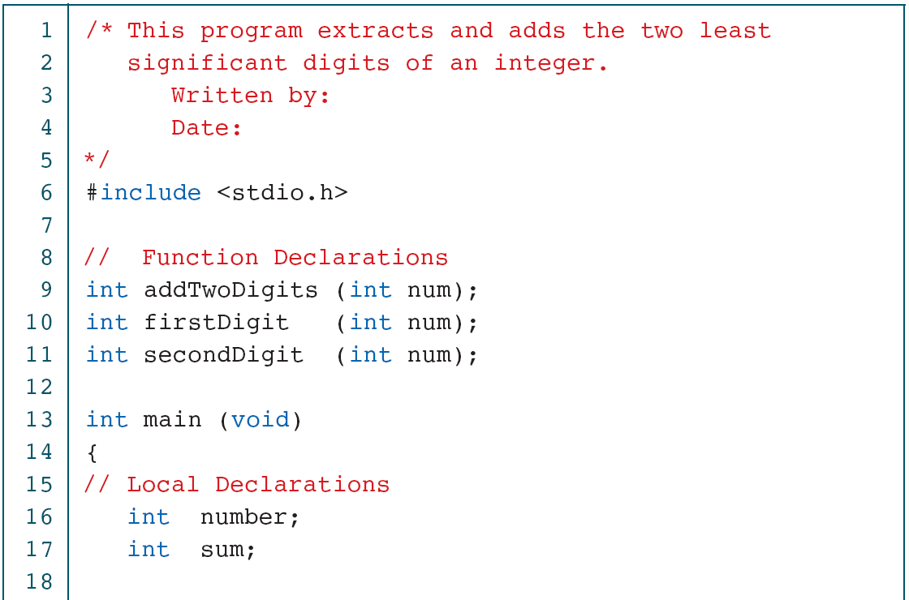
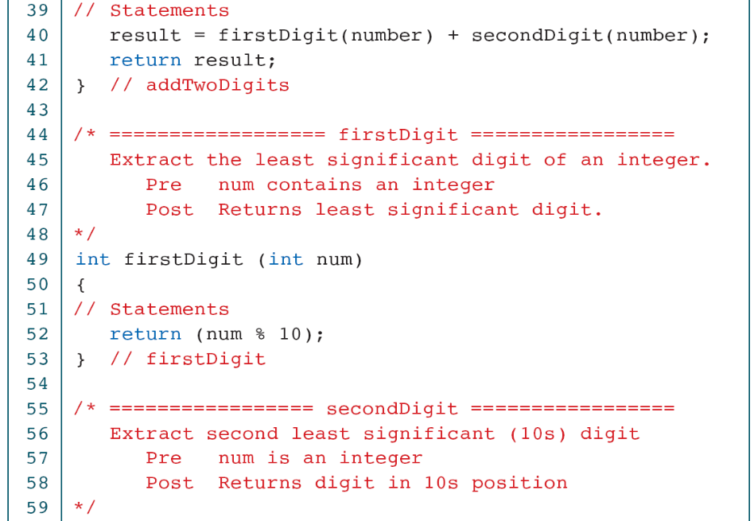
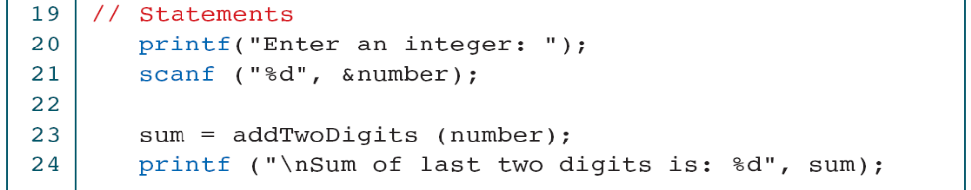
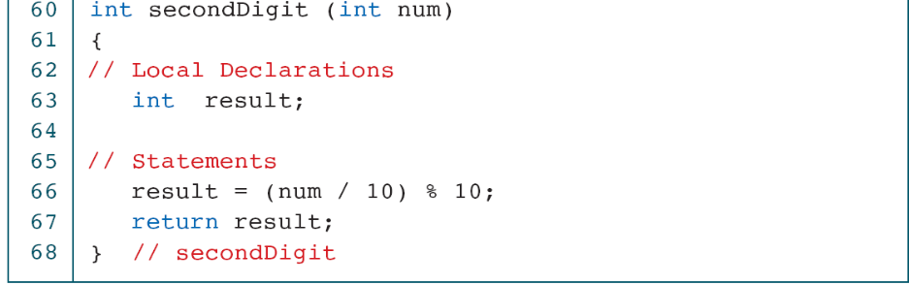
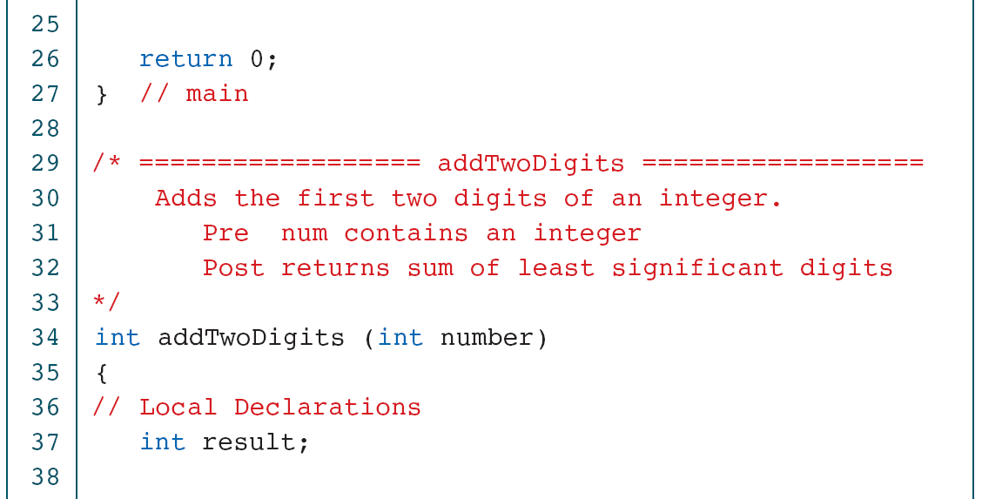
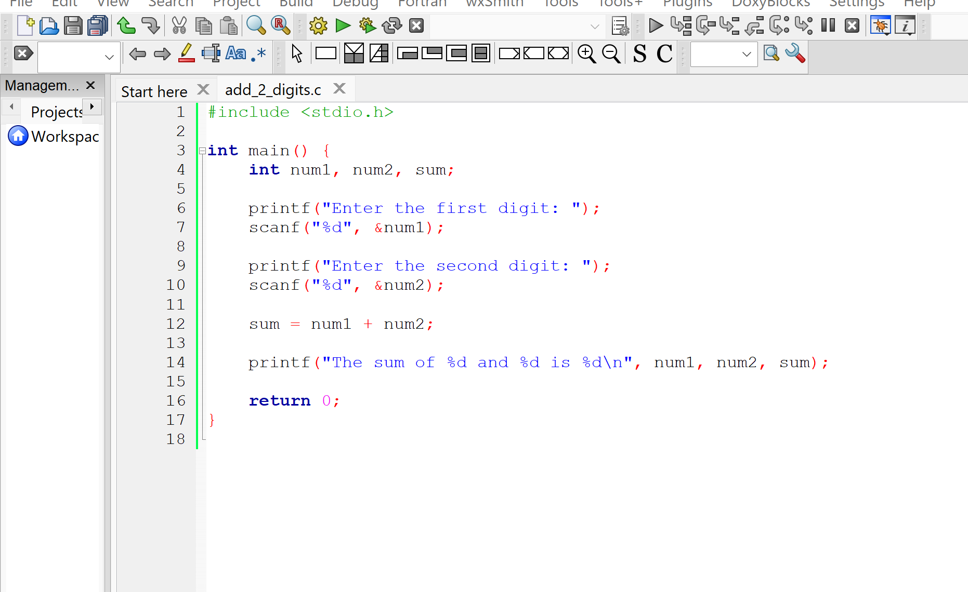
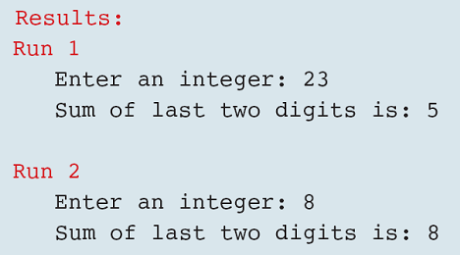
PROGRAM 4-5
Add Two Digits

Slide 31
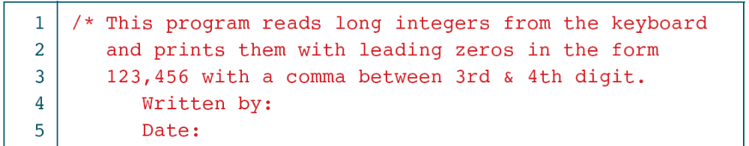
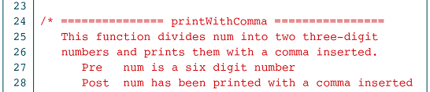
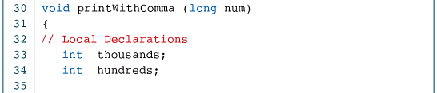
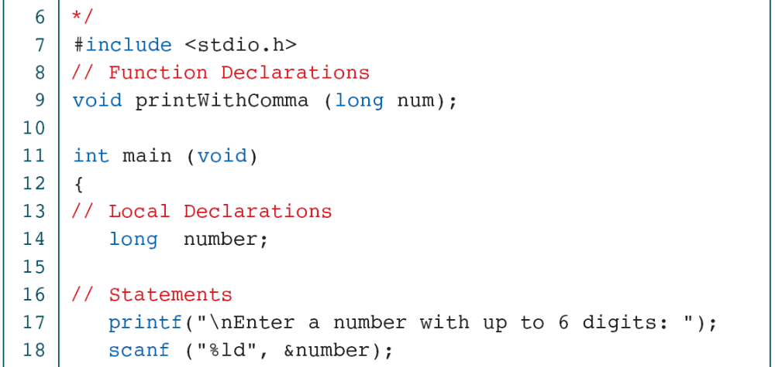
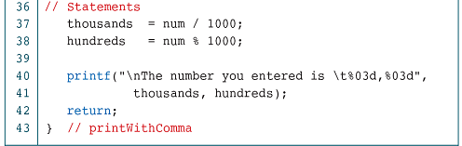
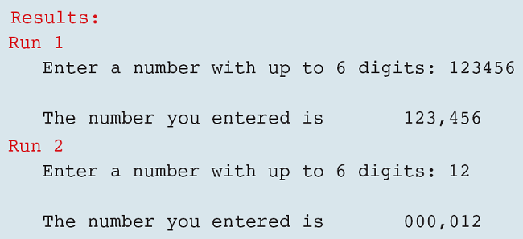

PROGRAM 4-6
Print Six Digits with Comma

Slide 32
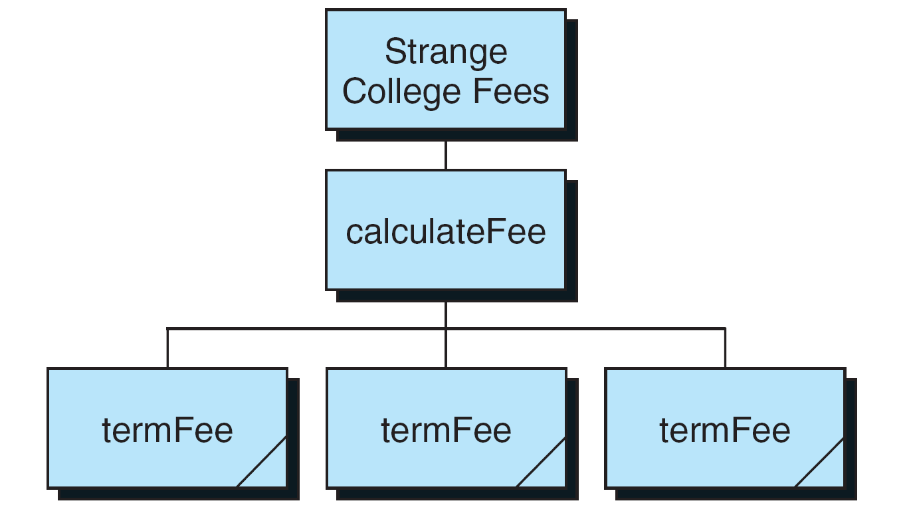
FIGURE 4-15 Design for Strange College fees

Slide 33
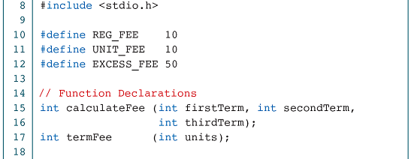
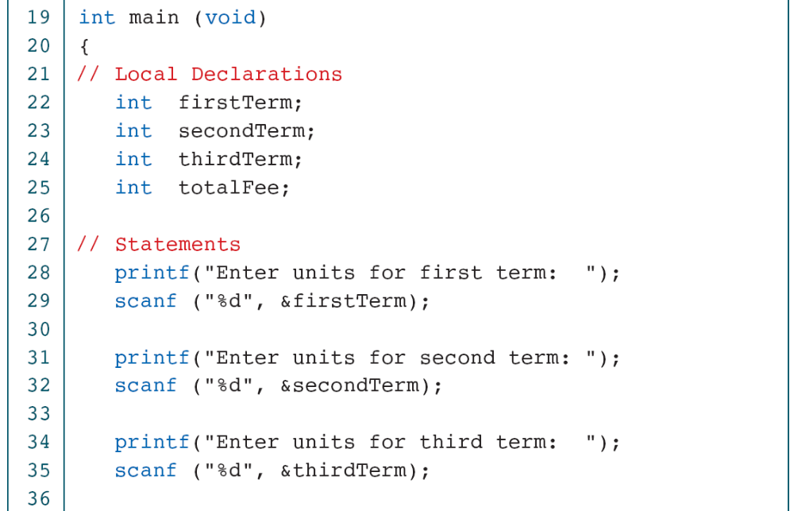
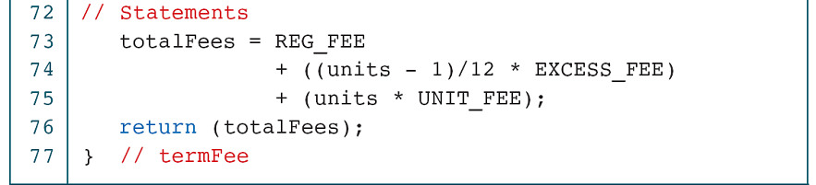
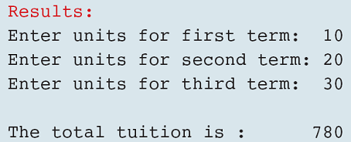
/* This program prints the tuition at Strange College. Strange charges $10 for registration, plus $10 per unit and a penalty of $50 for each 12 units, or fraction of 12, over 12. */
PROGRAM 4-7
Strange College Fees

Slide 34
4-4 Inter-Function Communication
Although the calling and called functions are two separate entities, they need to communicate to exchange data. The data flow between the calling and called functions can be divided into three strategies: a downward flow, an upward flow, and a bi-directional flow.
Topics discussed in this section:
Basic Concept
C Implementation

Slide 35
FIGURE 4-16 Data Flow Strategies

Slide 36
FIGURE 4-17 Downward Communication in C

Slide 37
FIGURE 4-18 Downward Communication

Slide 38
Call by address
FIGURE 4-19 Upward Communication in C

Slide 39
FIGURE 4-20 Upward Communication

Slide 40
Note
To send data from the called function to the calling function:
1. We need to use the & symbol in front of the data variable
when we call the function.
2. We need to use the * symbol after the data type when we
declare the address variable
3. We need to use the * in front of the variable when we
store data indirect

Slide 41
FIGURE 4-21 Bi-directional Communication in C

Slide 42
%
FIGURE 4-22 Bi-directional Communication

Slide 43
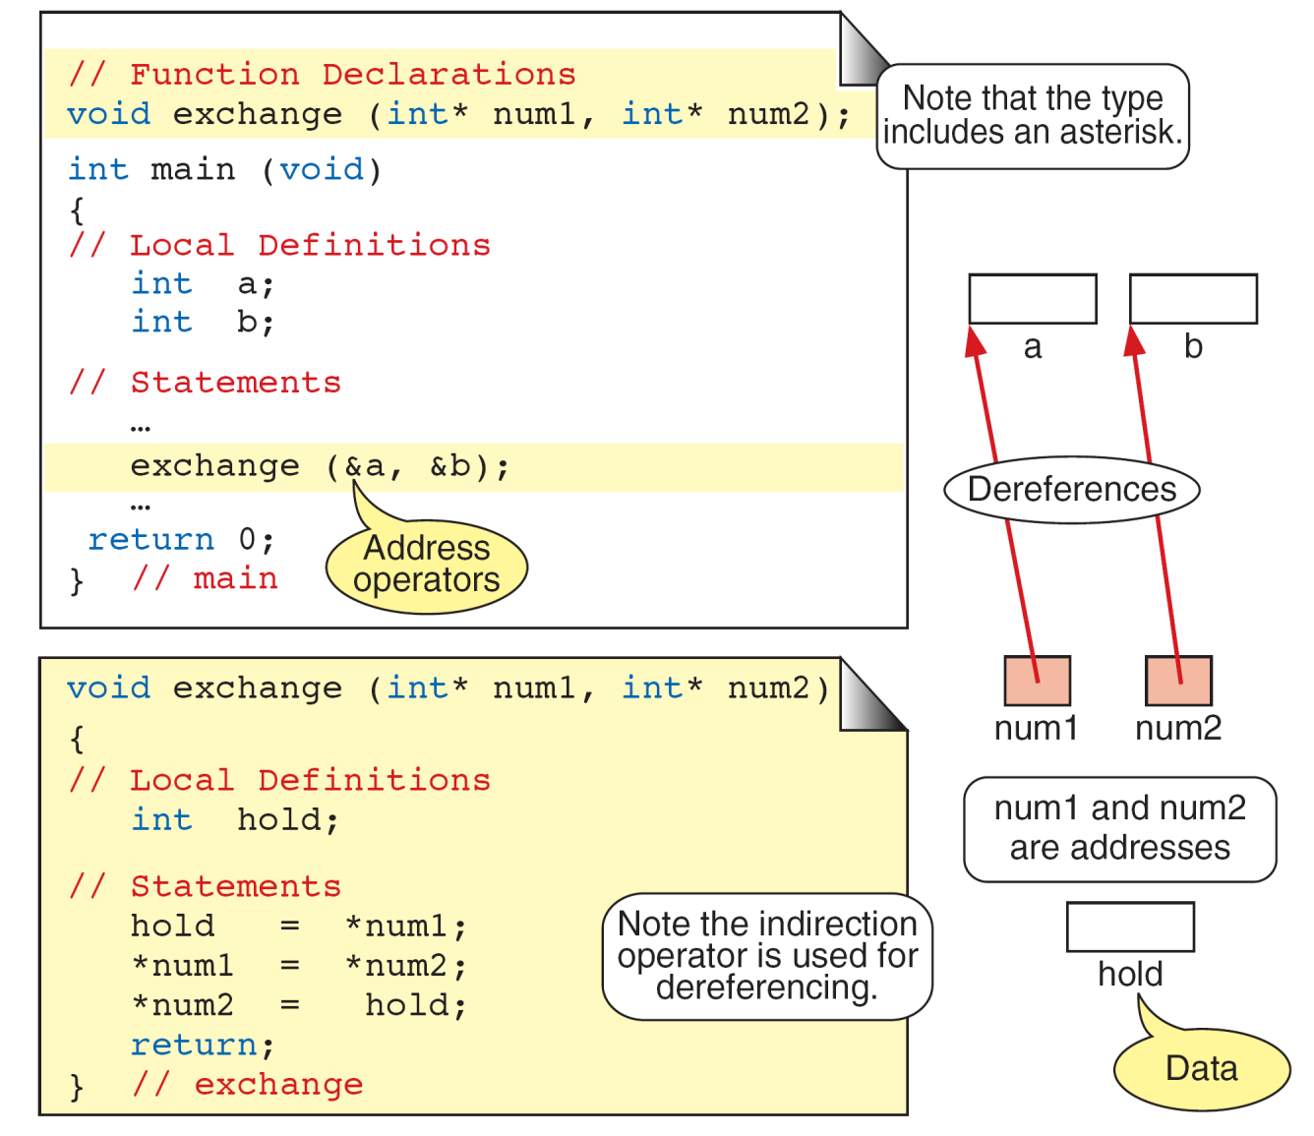
FIGURE 4-23 Exchange Function

Slide 44
FIGURE 4-24 Calculate Quotient and Remainder

Slide 45
FIGURE 4-25 Quotient and Remainder Design

Slide 46
PROGRAM 4-8
Quotient and Remainder

Slide 48
4-5 Standard Functions
C provides a rich collection of standard functions whose definitions have been written and are ready to be used in our programs. To use these functions, we must include their function declarations.
Topics discussed in this section:
Math Functions
Random Numbers

Slide 49
FIGURE 4-26 Library Functions and the Linker

Slide 50
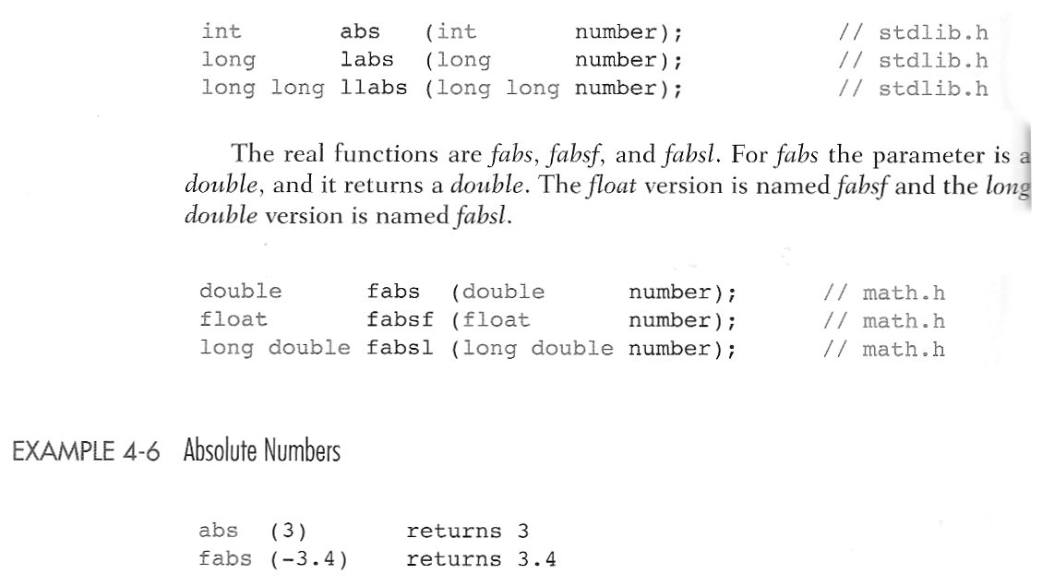
Absolution Value Functions

Slide 51
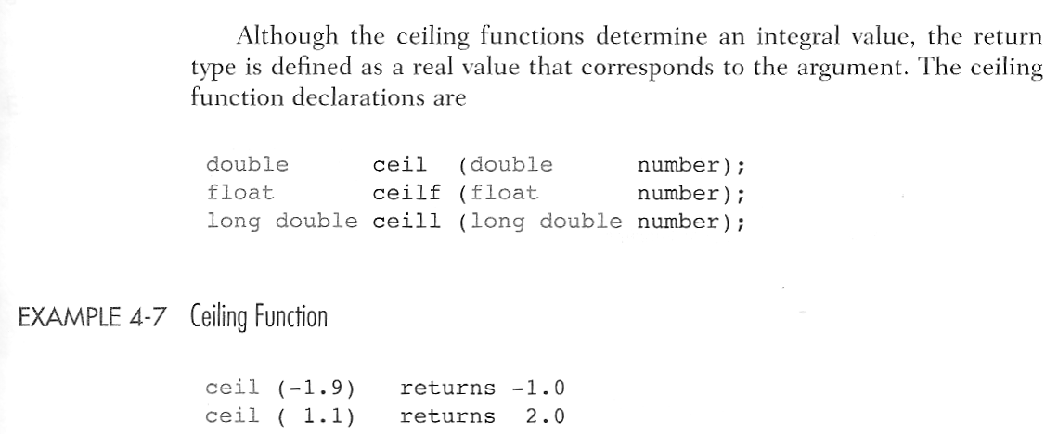
FIGURE 4-27 Ceiling Function

Slide 52
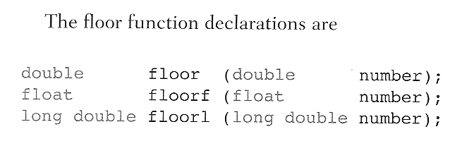
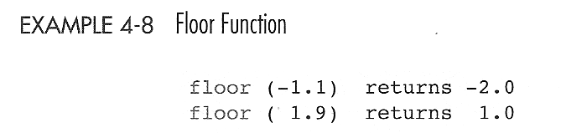
FIGURE 4-28 Floor Function

Slide 53
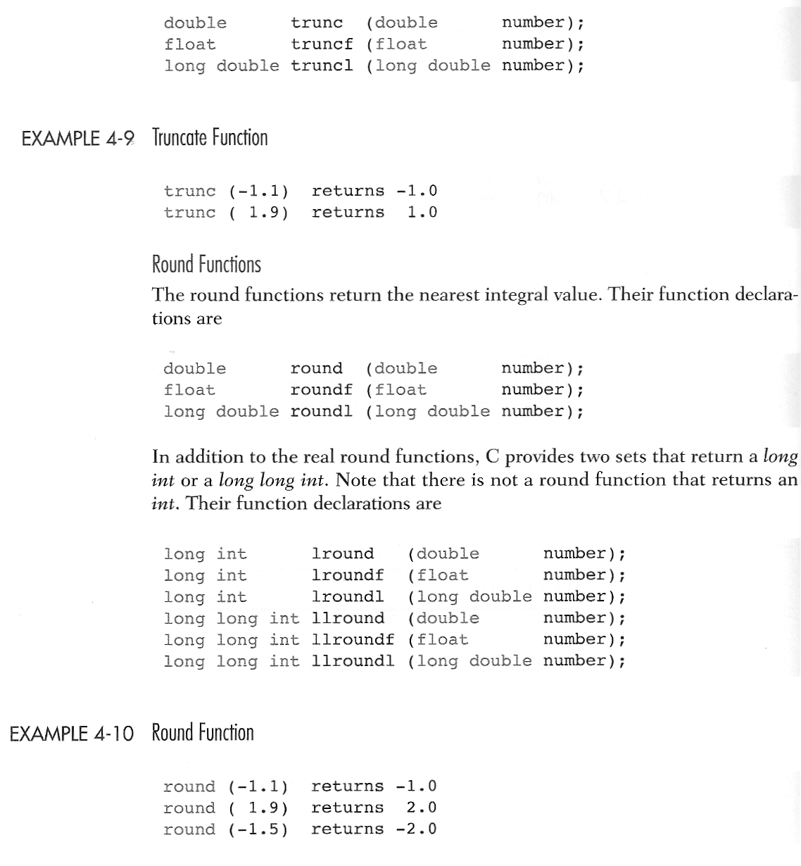
Truncation and Round Function

Slide 54
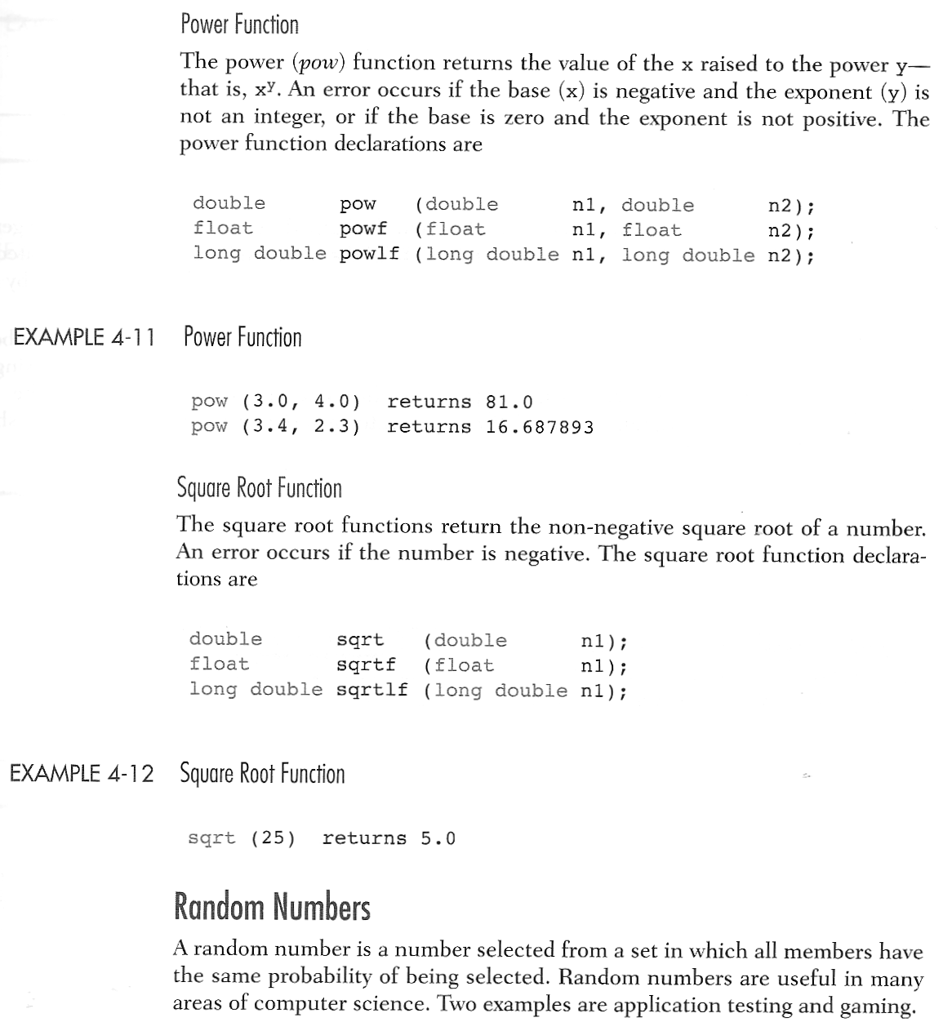
Power and Square Root Function

Slide 55
Random numbers
FIGURE 4-29 Random Number Generation

Slide 56
FIGURE 4-30 Generating a Random Number Series

Slide 57
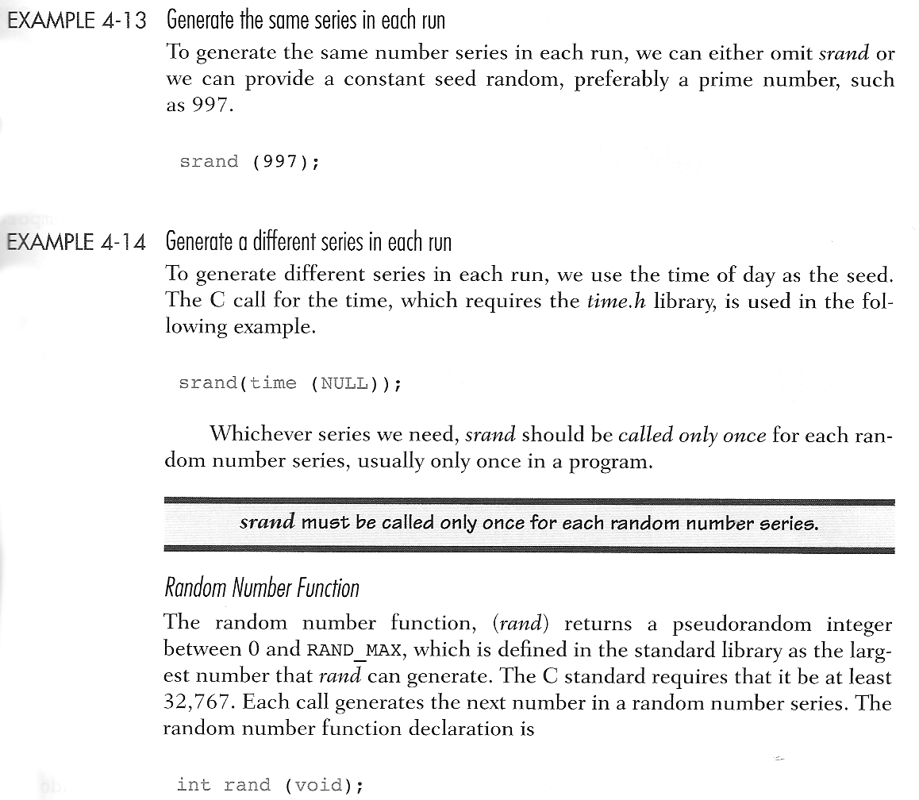
Note
srand must be called only once for each random
number series.

Slide 58
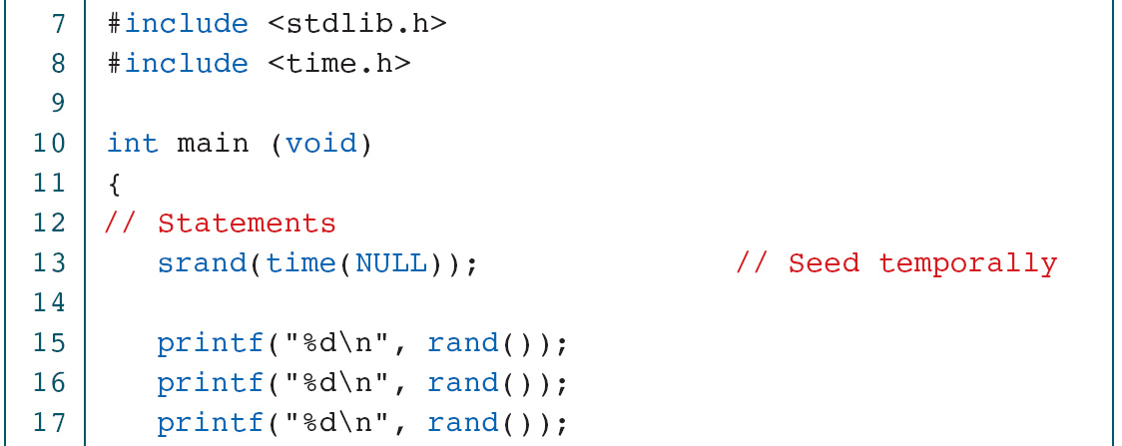
PROGRAM 4-9
Creating Temporal Random Numbers

Slide 59
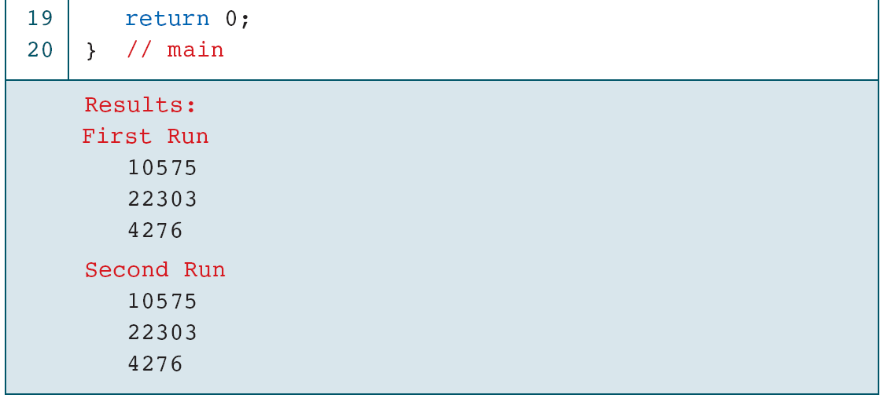
PROGRAM 4-10
Creating Pseudorandom Numbers

Slide 60
FIGURE 4-31 Random Number Scaling for 3–7

Slide 61
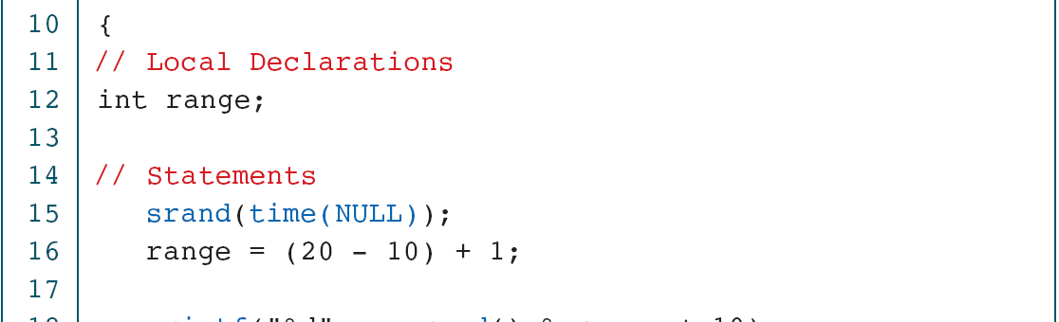
PROGRAM 4-11
Generating Random Numbers in the Range 10 to 20

Slide 62
PROGRAM 4-12
Generating Random Real Numbers

Slide 63
4-6 Scope
Scope determines the region of the program in which a defined object is visible. Scope pertains to any object that can be declared, such as a variable or
a function declaration.
Topics discussed in this section:
Global Scope
Local Scope

Slide 64
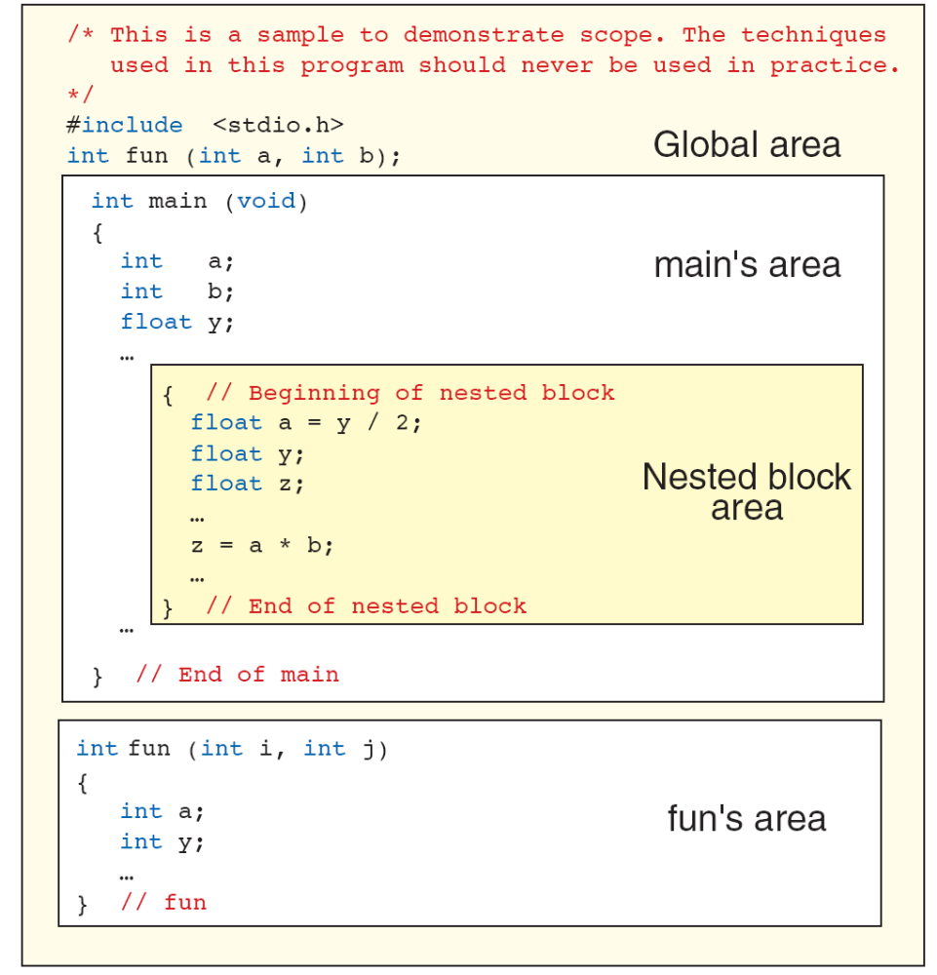
FIGURE 4-32 Scope for Global and Block Areas

Slide 65
Note
Variables are in scope from declaration until the
end of their block.

Slide 66
4-7 Programming Example—
Incremental Development
Top–down development, a concept inherent to modular programming, allows us to develop programs incrementally. By writing and debugging each function separately, we are able to solve the program in smaller steps, making the whole process easier.
Topics discussed in this section:
First Increment: main and getData
Second Increment: add
Final Increment: Print ResultsThe

Slide 67
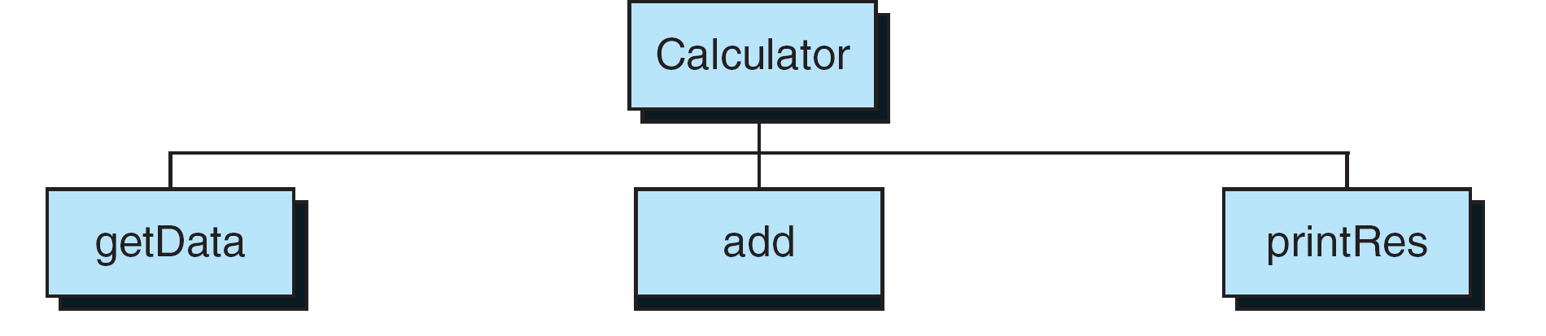
FIGURE 4-33 Calculator Program Design

Slide 68
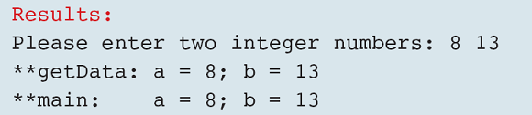
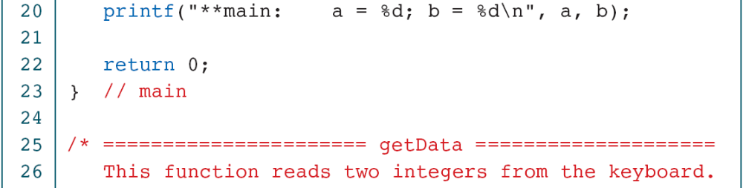
PROGRAM 4-13
Calculator Program—First Increment

Slide 69
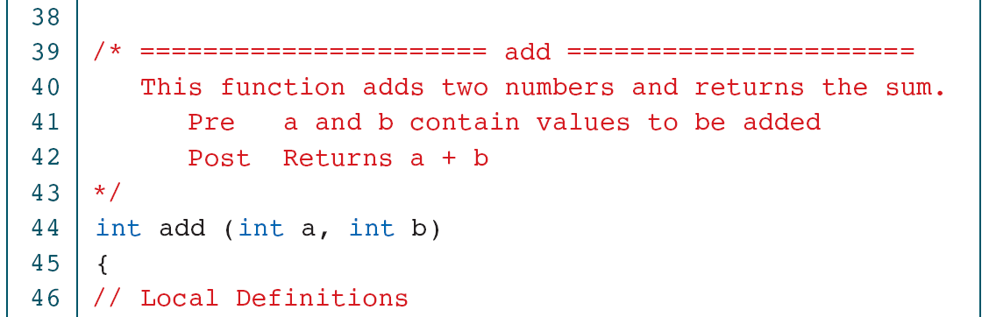
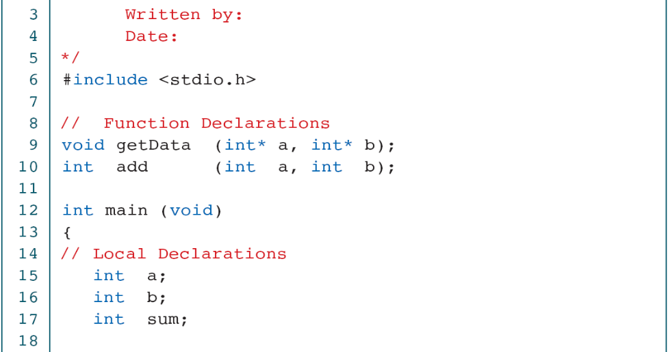
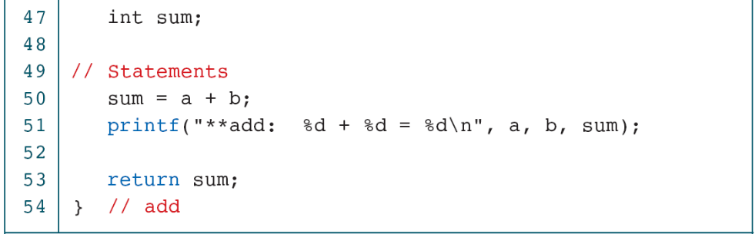
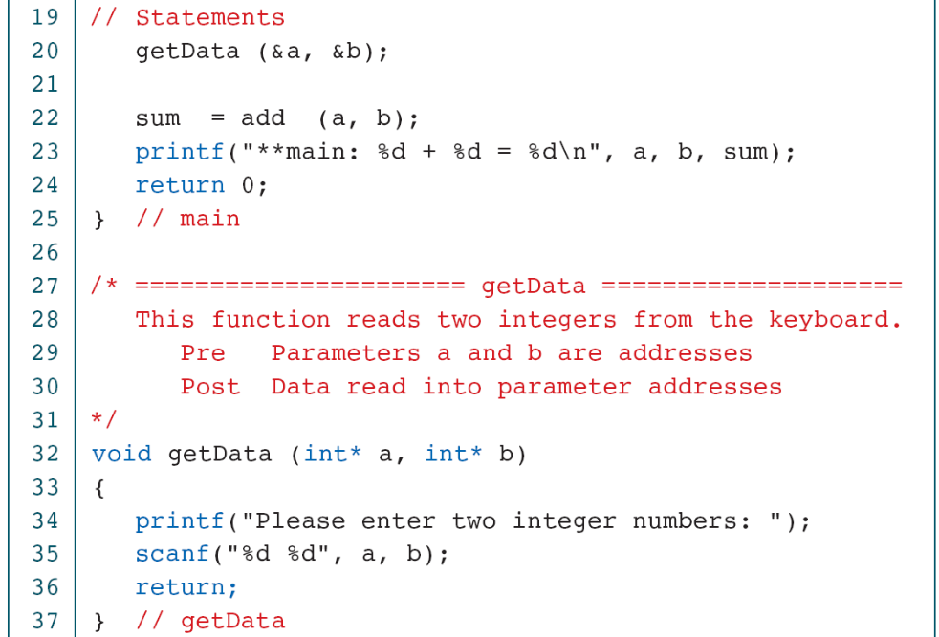
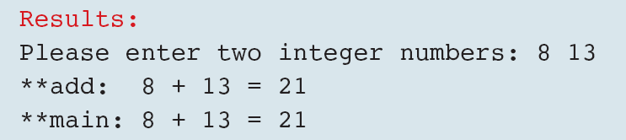
PROGRAM 4-14
Calculator Program—Second Increment

Slide 70






PROGRAM 4-15
Calculator Program—Final Increment

